Slide 1

Inventory management system

Slide 2
TEAM MEMBERS
NAVEEN B
MOULI MONISH S
LOGU N
KARTHIK G

Slide 3
Abstract
This project presents a robust Inventory Management System tailored for both sellers and suppliers, ensuring seamless operations for product handling, order tracking, and category management.
Key Features:
Designed specifically to streamline the workflow of sellers and suppliers by giving them role-specific functionalities.
Built using Java for core logic, JDBC for connectivity, Maven for efficient dependency and build management, and MySQL as the backend database.
Offers a user-friendly interface with secure registration and login, ensuring only authenticated users can access functionalities based on their roles.
Supports live updates for products, orders, and categories, keeping the database synchronized with real-time actions.

Slide 4
Technology Stack
Java (JDK 11+): The backbone of the application, responsible for the core business logic and application flow.
MySQL: A robust and scalable relational database used for storing all system data including user information, products, orders, and categories.
Maven: Handles project building and manages external libraries efficiently, ensuring seamless integration of dependencies.
JDBC (Java Database Connectivity): Acts as the bridge between Java code and the MySQL database, enabling smooth data operations.
IntelliJ IDEA: Chosen as the development environment for its powerful Java support, productivity tools, and integration features.
ANSI Color Codes: Used to enhance the console UI, making navigation and operation more intuitive through color-coded prompts and messages.

Slide 5
Working – User Management
The system allows users to register by choosing a role—Seller or Supplier—and creating login credentials. Upon successful login, the system grants role-specific access, ensuring that each user sees only the operations relevant to their role. Sellers can view and manage orders and products, while suppliers handle product inventory and categories. This structured approach ensures data security, proper functionality segregation, and a smooth user experience.
Seller
Supplier
View, update, search products
Place/cancel orders
Real-time order status
Add, update, delete products
Manage categories
View seller orders

Slide 6
Working: Seller & Supplier Functions
View Products: Browse available products with details like name, category, and availability.
Update & search Products: Search products based on parameters and update limited fields (like order quantity).
Place or Cancel Products: Sellers can create new orders or cancel existing ones, with automatic inventory adjustment.
Real time Order Status: Order states are updated live, reflecting processing, completed, or canceled status.

Slide 7
Supplier Functionalities:
Add Products: Insert new products into the inventory along with category and quantity.
Update/Delete Products: Modify existing product details or remove them if no longer available.
Manage Categories: Create or delete product categories to keep the inventory organized.
View Seller Orders: Access all orders placed by sellers, aiding in fulfillment and logistics.

Slide 8
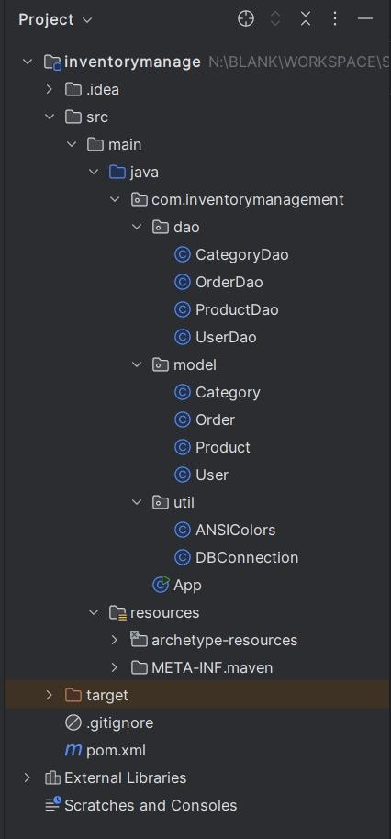
Project Structure

Slide 9
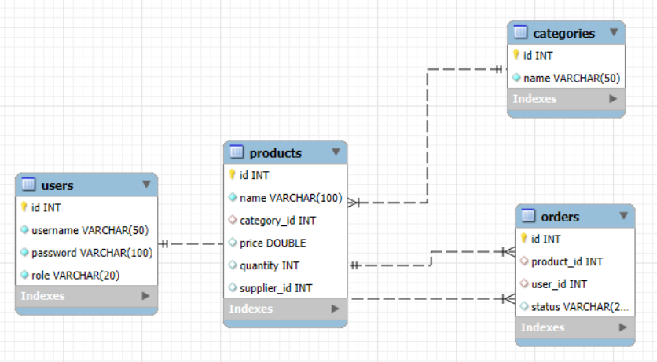
ER Diagram for inventory management

Slide 10
Conclusion
The Inventory Management System is a scalable and efficient console-based application that delivers a clear separation of roles and responsibilities between sellers and suppliers.
Highlights:
Ensures robust role-based operations, minimizing errors and unauthorized actions.
Maintains real-time data integrity with instant updates to the database on every user action.
Provides a clean and responsive console interface, improving the user experience with colored outputs.
The system is modular and extensible, making it easy to enhance further by integrating features like reporting, analytics, or even GUI-based interfaces.

